Slide 1
Association Between Healthy Lifestyle Behaviors and Cancer History
Jennifer Frediani, RD, PhD, ACSM-CES

Slide 2
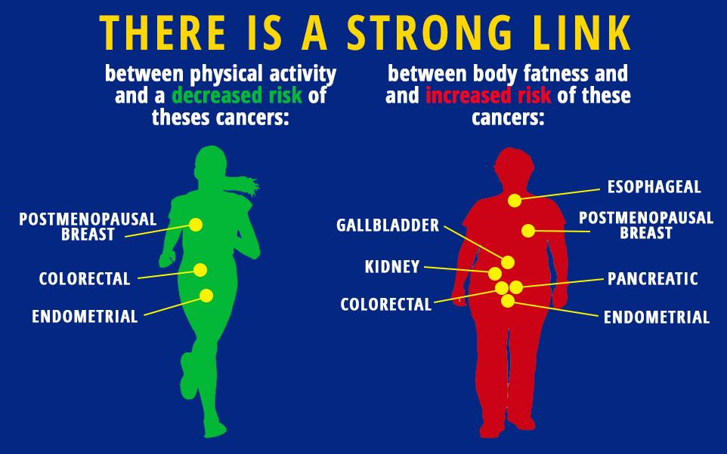
Background
Fruit and vegetable intake and physical activity have an effect on the prevention of cancer.
The differences in these lifestyle behaviors has not been investigated between those with cancer and those with just a family history of cancer.
The Health Information National Trends Survey (HINTS) is a nationally represented survey conducted by the National Cancer Institute (NCI) to collect data about the American public’s use of cancer-related information.
HINTS 4 Cycle 2 includes all of the health behaviors plus information on cancer history and demographics

Slide 4
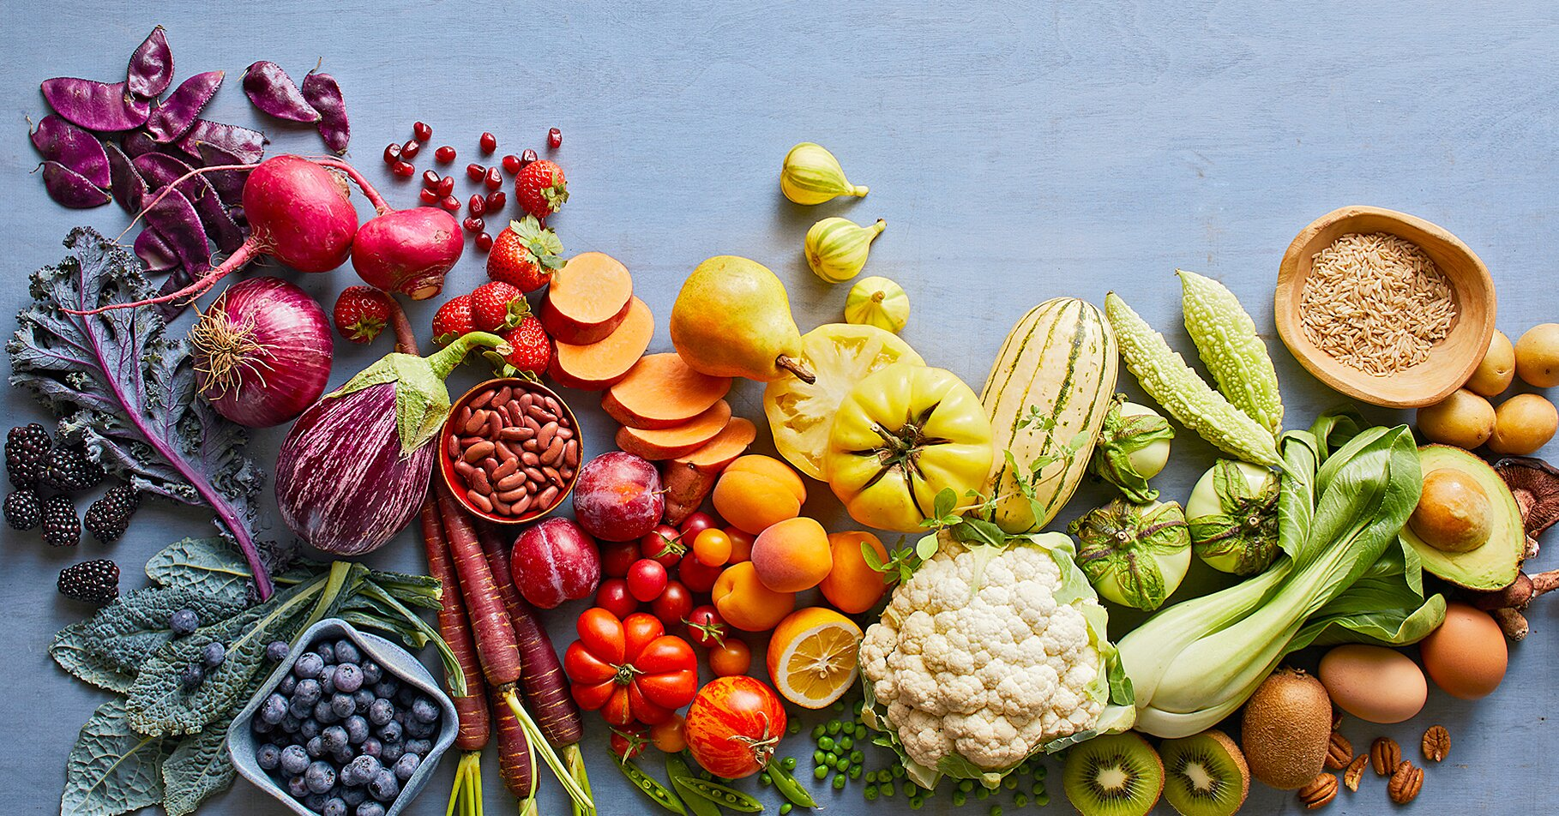
Methods
Data wrangling in R with a SPSS dataset
HINTS specific data issues
Missing coding
Physical activity variables
Dataset split for modeling (80/20)
Multivariate logistic regression
Prediction plots
Confusion matrix
ROC and AUC

Slide 5
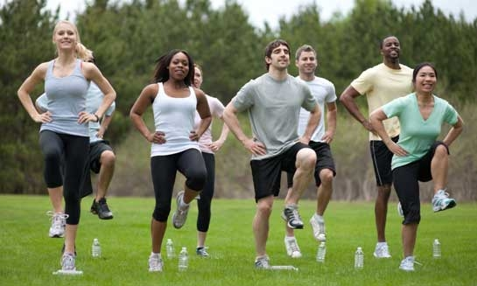
Results
3630 total survey participants in this cycle
464 that ever had cancer (or currently have cancer)
2412 with a family history of cancer
Significant differences between cancer and no cancer: age, race/ethnicity, marital status, education, income, smoking status
Significant differences between family history and no history: sex, race/ethnicity, smoking status

Slide 6
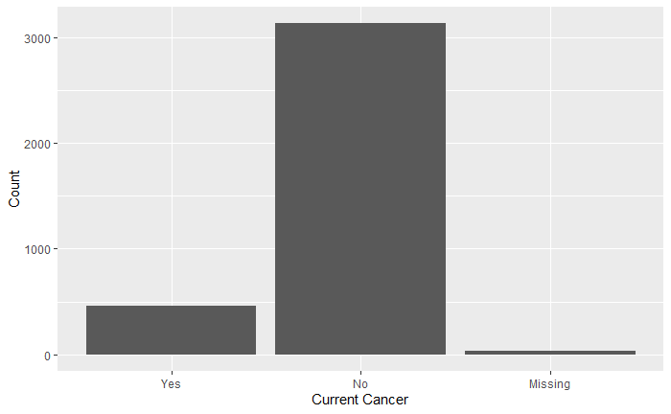
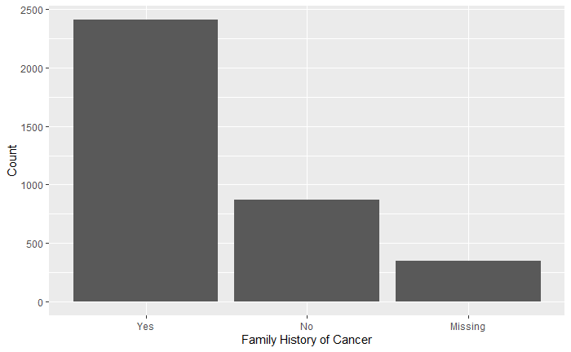
Prevalence of Cancer and Family History
3135
2412
870
464
31
348

Slide 7
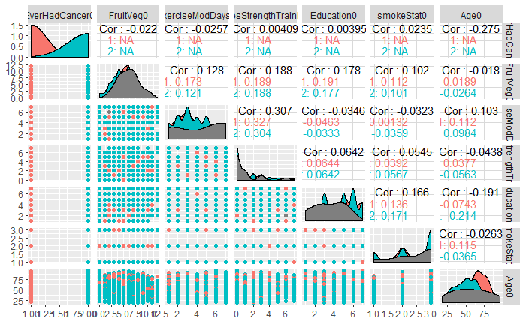
Correlation Matrix for Covariates

Slide 8
Odds Ratio for Each Model
 | Family History of Cancer |  | Current Cancer
Fruit and Veg Model | Odds Ratio | 95% CI | Odds Ratio | 95% CI
Intercept | 0.21 | 0.12, 0.36 | 251.72 | 118.53, 548.89
Fruit and Vegetable intake | 1.01 | 0.97, 1.05 | 0.97 | 0.93, 1.03
Education | 0.98 | 0.93, 1.04 | 0.91 | 0.85, 0.98
Age | 1.00 | 0.99, 1.00 | 0.94 | 0.93, 0.95
Smoking Status | 1.28 | 1.13, 1.46 | 1.17 | 0.99, 1.37
Exercise Model | Odds Ratio | 95% CI | Odds Ratio | 95% CI
Intercept | 0.26 | 0.14, 0.50 | 445.83 | 172.51, 1202.54
Aerobic Exercise Days | 0.97 | 0.92, 1.03 | 1.00 | 0.93, 1.08
Education | 0.98 | 0.92, 1.05 | 0.86 | 0.79, 0.94
Age | 1.00 | 0.99, 1.01 | 0.93 | 0.92, 0.94
Smoking Status | 1.28 | 1.1, 1.49 | 1.21 | 0.97, 1.48

Slide 9
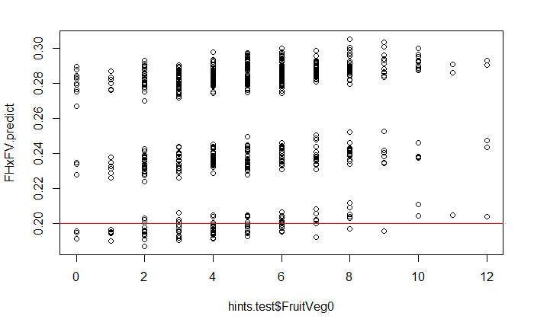
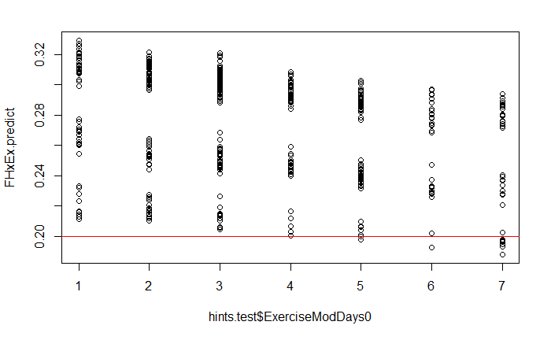
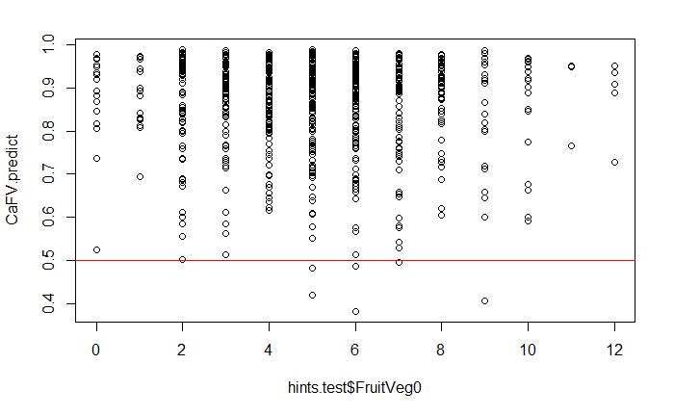
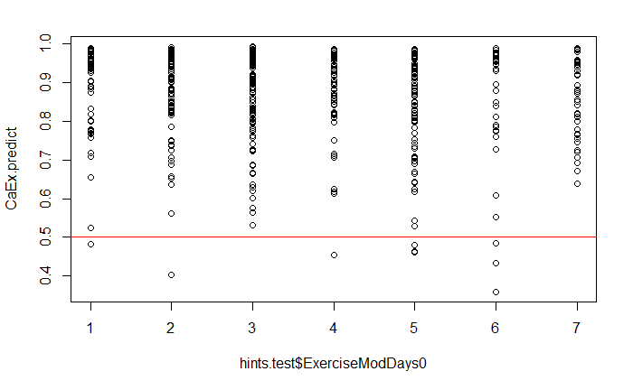
Prediction Probabilities
Family History Prediction
Fruits and Vegetables (cups)
Moderate Aerobic Exercise (days)
Current Cancer Prediction
Fruits and Vegetables (cups)
Moderate Aerobic Exercise (days)

Slide 10
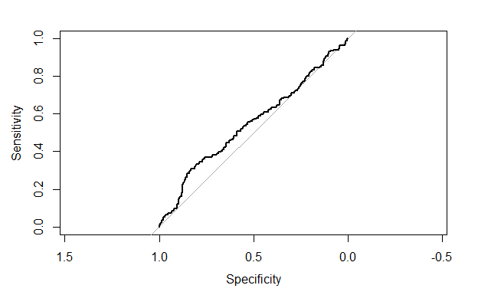
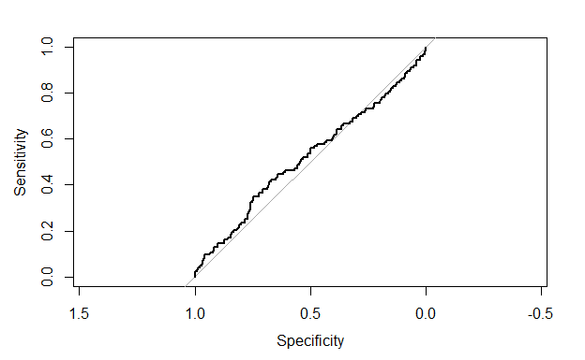
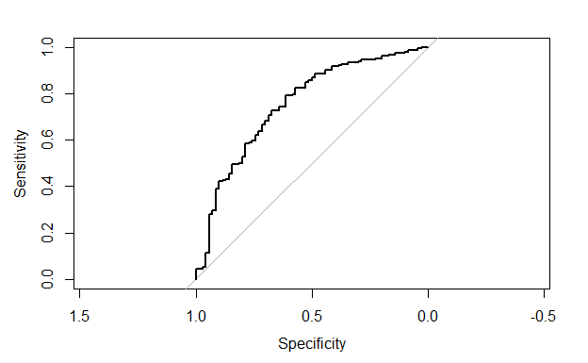
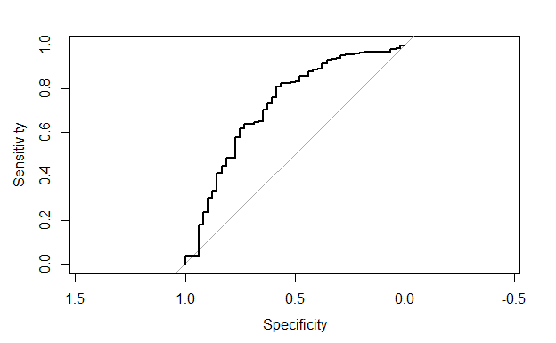
ROC and AUC Results
Family History of Cancer ~ Fruits and Vegetables
Family History of Cancer ~ Days of Aerobic Exercise
AUC – 0.55
AUC – 0.52
Current Cancer ~ Fruits and Vegetables
Current Cancer ~ Days of Aerobic Exercise
AUC – 0.75
AUC – 0.72

Slide 11

Conclusions
There was not significant association between fruit and vegetable intake or days of moderate exercise and family history of cancer.
There may be a slight association between fruit and vegetable intake and days of moderate exercise and current cancer status based on ROC and AUC results.
Smoking status is the most significant covariate in either model.
Those that have had or currently have cancer may be more motivated to change lifestyle behaviors than those with just a family history.

Slide 12

Lessons Learned
SPSS does not play well with R
More comfortable with R now than before
Public datasets appear clean on the surface
But often have quirky issues

